Slide 1
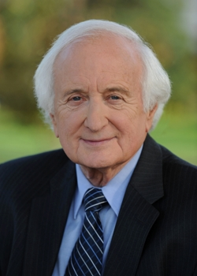
Getting to Know Your LEOs
Congressman Sander Levin – MI 9th District
Presented by Kyle Pollet
June 3, 2016

Slide 2
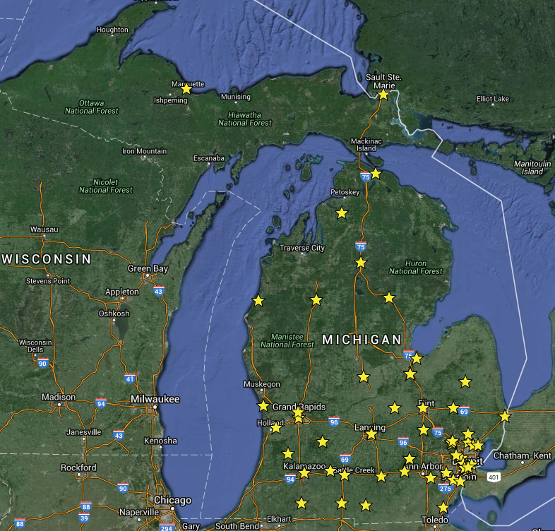
Free Health Clinics in Michigan

Slide 3
Get to know your LEOs and their Jurisdictions
City Council Persons:
Community events
Operation ordinances
Local services
Community casework
County Commissioners:
Vital records
Community mental health boards
Population specific agencies:
Meals on Wheels
Homeless services
Services for low income residents
Community casework
State Representative/ Senator:
Michigan Medicaid oversight
Department of Health and Human Services
State administered grants
Community casework
Federal Representative:
Affordable Care Act Marketplace
Medicare
Federal Grants
Community casework

Slide 4
What They Want to Know About You
(numbers! numbers! numbers!)
City Council Persons:
What is your impact in the local community?
Are you hosting any events they can attend?
They need to know how your clinic is benefitting the community.
County Commissioners:
How is the county doing in the area of services to uninsured individuals?
What additional services are needed?
How does your clinic fit into the county community as a whole? Are you serving the whole county?
State Representative/ Senator:
What have been the impacts of expanded Medicaid on your patients?
Why are your patients not able to qualify for Medicaid or ACA?
Federal Representative:
How has ACA impacted your clinic? Do you ever see people who are underinsured through Medicare?
What is needed in federal law to better serve your patients?

Slide 5
Benefits
Social Media: Ask and you shall receive! (Local/County/State/Federal)
Grant and funding opportunities: The next grant request you write should have a letter of support attached to it! This is easiest for us to do the better we know you. (State/Federal)
Advocacy in budgeting and appropriations: We need your numbers and stories to appropriately invest in the healthcare of our state. (County/State/Federal)
Casework Liaisons: All levels of govt. have the phone numbers of the agency directors they have oversight of. Provide a warm handoff for patient issues you do not handle. (Local/County/State/Federal)
Networking: You know people we don’t, and vice versa. When we work as a unified community, we do better by each other. (Local/County/State/Federal)

Slide 6
501(c)(3) Concerns Working with Electeds
Allowed
Donations from the LEO’s campaign to you.
Hosting or participating in events with the LEO (as long as they are through official office).
Presenting educational information in a public setting.
Meeting with your LEO to educate them on the issues facing your patients.
Not Allowed
Donations to the LEO from you.
Advocating for or against a political party or candidate.
Any campaign activities (strict division between official/campaign.)
“Substantial” Lobbying

Slide 7
Summary
We want to know you and help you!
What’s the best way to set up a meeting? Just call and ask for one!
How should you stay in touch? Through email and community events.
When should you ask for help? Whenever. If we can’t help you, we’re happy to find someone who can!
Questions?

